Slide 1
Manufacturing Technology
02/02/2018 (ME461)
Instructor: Shantanu Bhattacharya

Slide 2
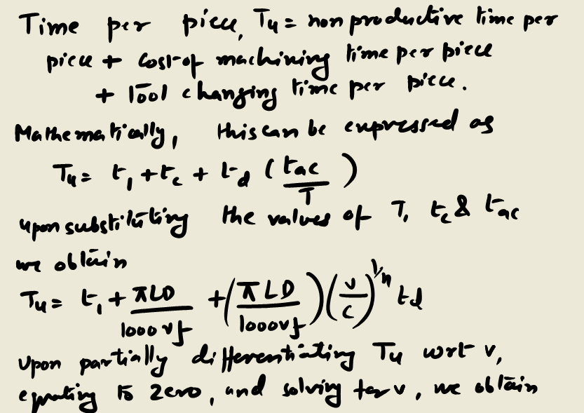
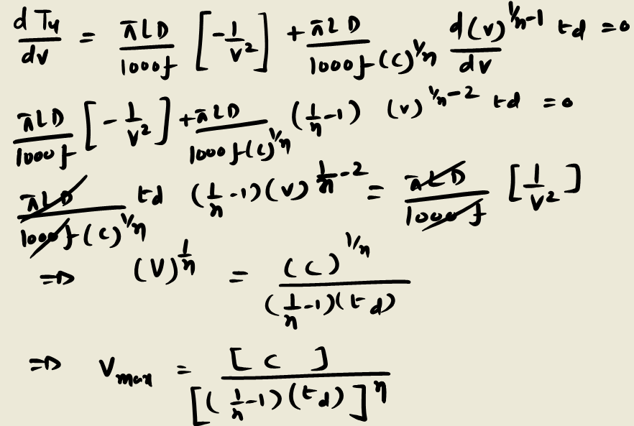

Maximum Production Rate Model
Another criterion used to determine the optimal conditions is maximum production rate which is inversely proportional to the production time per piece, which is given by:

Slide 3
Manufacturing Lead Time
Assuming that the lot size is Q units, then the average lead time to process these units will be .
Lead time = major setup time + T_{u}Q

Slide 4
Numerical Problem
A lot of 500 units of steel rods 30cm long and 6 cm in diameter is turned on a numerically controlled (NC) lathe at a feed rate of 0.2 mm per revolution and a depth of cut of 1mm. The tool life is given by:
vT^{0.20} = 200
The other data are:
Machine labor rate = $10/ hr.
Machine overhead rate = 50% of labor
Grinding labor rate = $10/hr
Grinding overhead rate = 50% of grinding labor
Work peice loading/ unloading time = 0.50 min/ piece
The data related to the tools are:
Brazed inserts
Original cost of the tool = $ 27.96
Grinding Time = 2min.
Tool changing time = 0.50 min. (The tool can be ground only five times before it is discarded.
Determine the following:
(a)Optimum tool life and optimum cutting speed to minimize the cost per piece.
(b)Optimum tool life and optimum cutting speed to maximize the production rate.
(c)Minimum cost per component, time per component, and corresponding lead time.
(d) Maximum production rate, corresponding cost per component, and lead time.

Slide 5
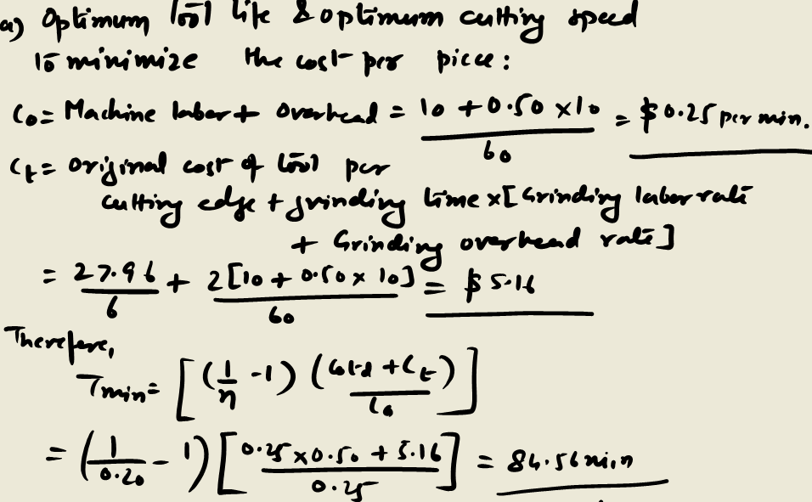

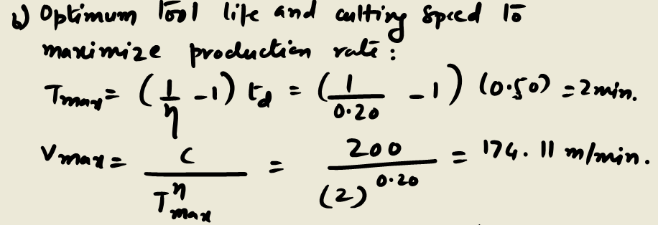
Solutions

Slide 6
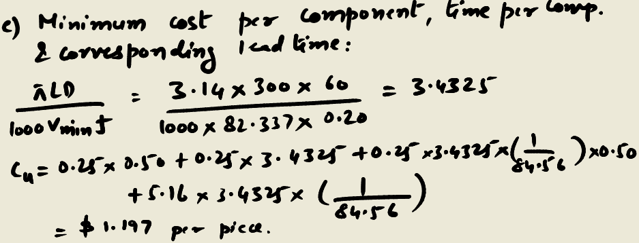
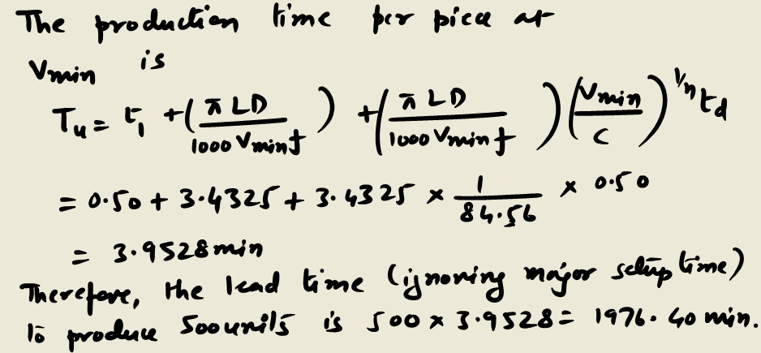
Solutions

Slide 7
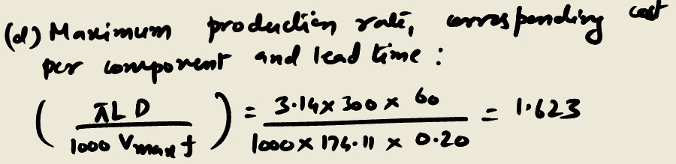
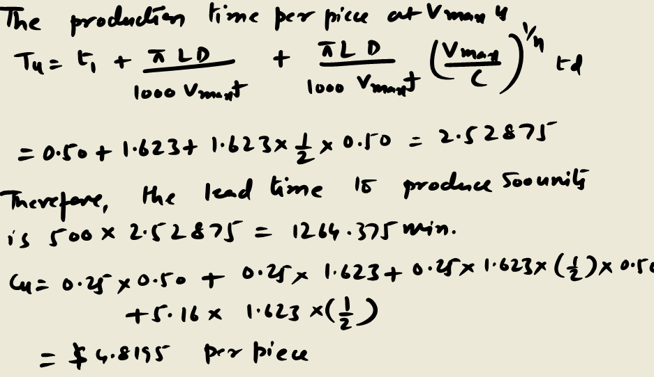
Solutions

Slide 8
The principal process planning approaches
The principal approaches to process planning are the manual experience based method and the computer aided process planning method.
The manual experience-based planning method:
The manual experience based methods have the same steps for manually generating a process plan as described earlier. However, it is a time consuming and inconsistent approach.
The feasibility of process planning is dependent on many upstream factors such as design and the availability of machine tools.
Also, a process plan has a great influence on many downstream manufacturing activities such as scheduling and machine tool allocation.
Therefore, to develop a process plan, process planners must have sufficient knowledge and experience. It may take a relatively longer time and is usually expensive to develop to skill of planners.

Slide 9
Computer aided process planning
The primary purpose of a process planning activity is to translate a design of any product into manufacturing process details.
This prima facie suggests a feed forward system in which the design information is directly processed by a CAPP system to layout a manufacturing plan. However, this does not rhyme very well with the concurrent engineering philosophy where design is an integral part in all steps of a manufacturing unit.
So, somehow we have to integrate the CAPP system into the inter-organizational flow.
For example if we change the design we should be able to fall back on a CAPP system to generate cost estimates of these design changes.
Similarly, if there is a breakdown the CAPP should be able to suggest an alternative plan so that the most economical situation can be adopted.
The two major methods that are used in computer aided process planning: the variant CAPP and the generative CAPP method.

Slide 10
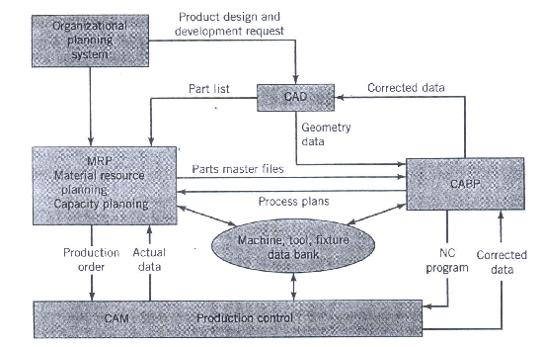
Framework for a CAPP system

